Slide 1

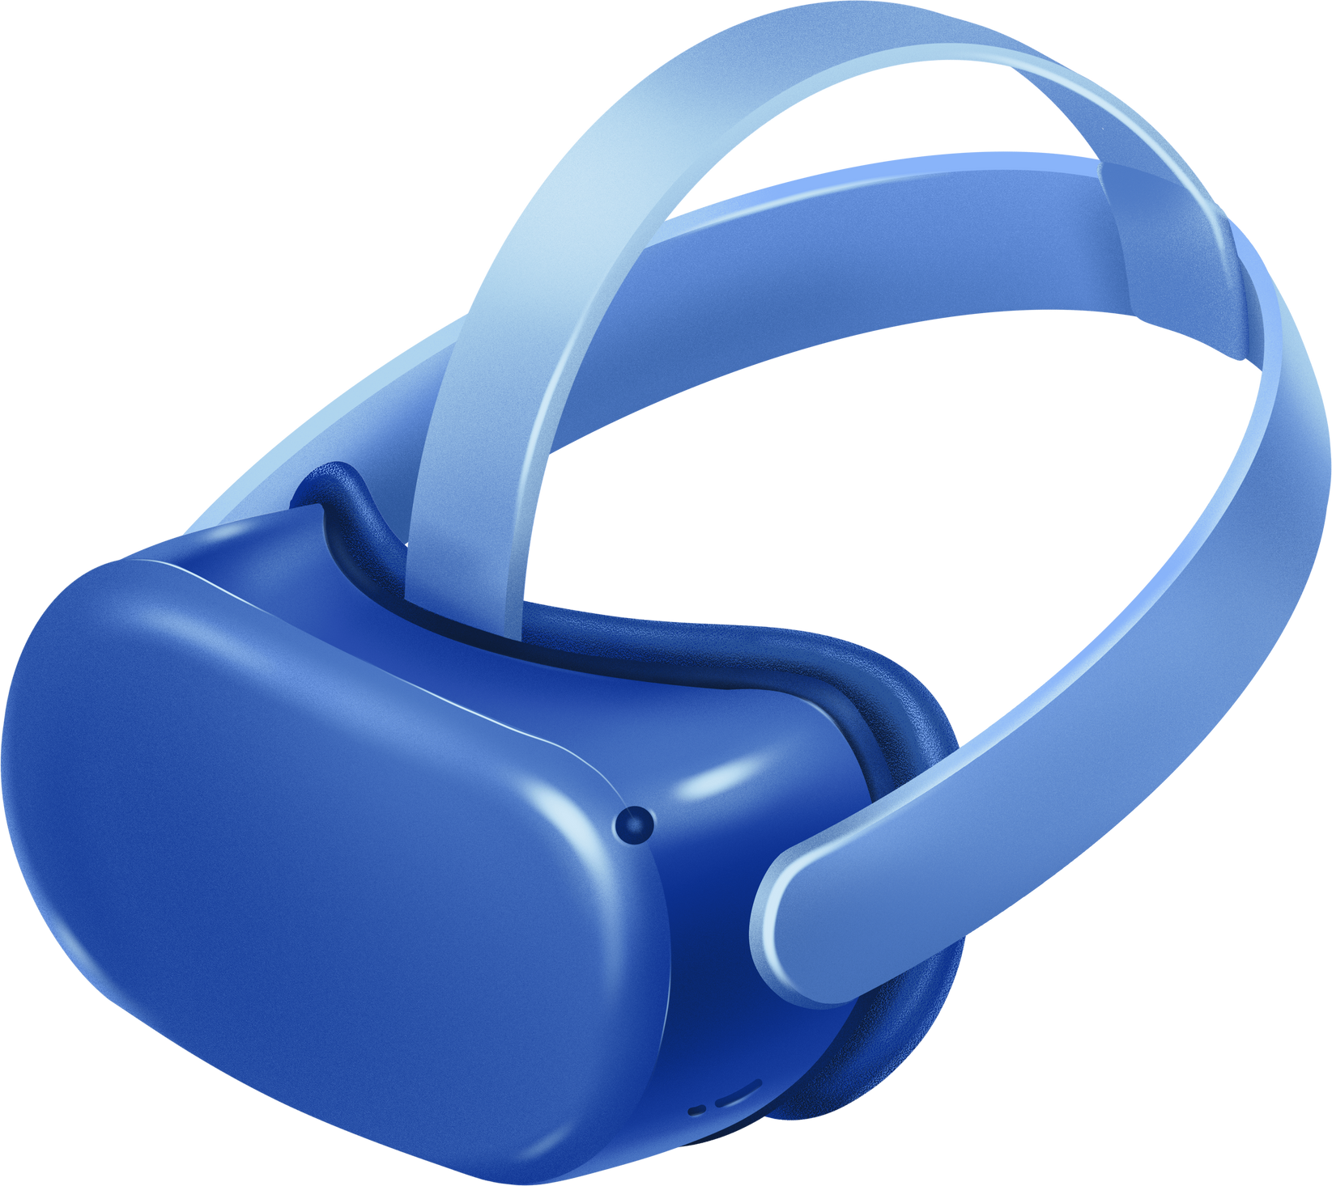

WELCOME TO THE WORLD OF
VIRTUAL REALITY
LET’S EXPLORE
DISCOVER HOW VR IS RESHAPING OUR LIVES AND EXPERIENCES.
01

Slide 2
SUPERVISION
Dr. Fatema Sayed
Eng. Ahmed Nasser
03

Slide 3
TEAM MEMBERS
Amr Mohammed Fathy
Basmala Sayed Salah Abd Almoaz
Mohammed Ibrahim Mohammed
Mostafa Ehab Mostafa El-Nahas
Mina Ehab Makin
03

Slide 4
DRUM VERSE
Drum Verse is a virtual reality applica on that transforms the way people experience and learn to play drums. By leveraging the latest in VR technology, Drum Verse creates an immersive drumming environment that's both educa onal and entertaining.
03

Slide 5

SPLASH SCREEN

Slide 6
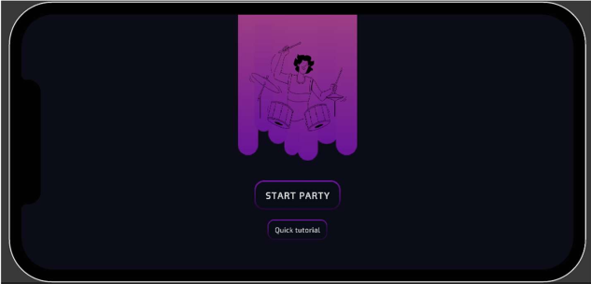
MAIN MENU SCENE

Slide 7

CONNECTION ACTIVE SCENE

Slide 8
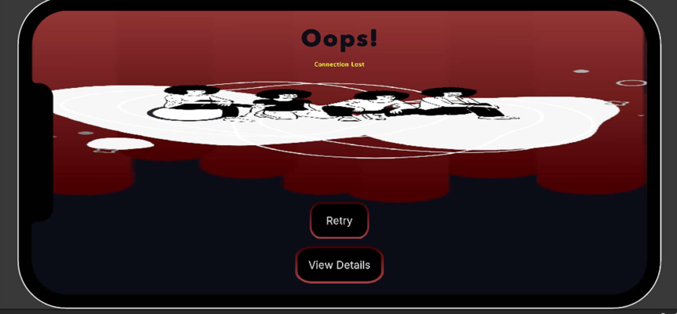
ERROR SCENE

Slide 9
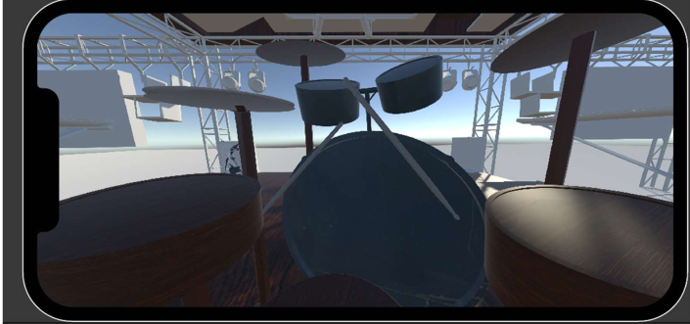
VR WORLD SCENE

Slide 10
THANK YOU!
10

